Slide 1
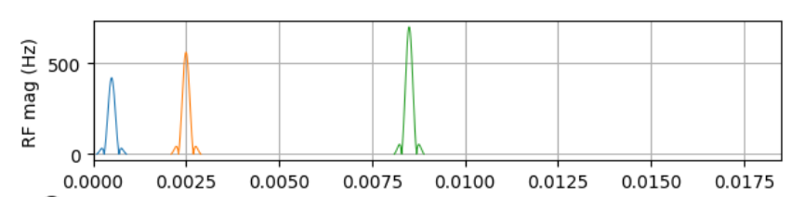
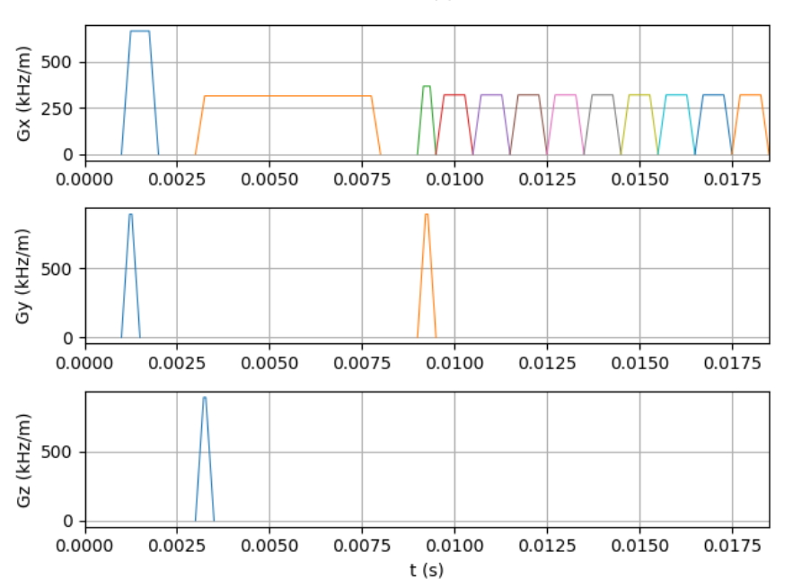
Exercise 1:
The correct spacing is 1, 3, 9, 27, 81,….
The high time-bw-product is used to generate narrow signals.
Exercise 2:
The flip angles to create ‚pure‘ signals are:
90-180-180
0-90-180
90-0-180
90-90-90
This will fail for the stimulated echo, which will also produce spin echoes.
Exercise 4:
only the first scheme (all phases idential to the phase of the excitation pulse is not a CPMG-sequence.
All other phase schemes are constructed according to:
0(exc) – 90+α – 90+3α – 90+5α – 90+7α....
for different values of α. (α just introduces a frequency shift and CPMG is invariant to frequency shifts.
Exercise 3:
you need identical spoilers after the first and third pulse and a different spoiler after the 2nd pulse to get rid of all spin echoes

